Slide 1
Superpixel preprocessing as data reduction in image recognition
Mitan Theodor-Alexandru
Coordonator: Lect. Dr. Benchea Razvan

Slide 2
Outline
In an effort to reduce computational effort and training time required for image recognition, clustering delivers a way to “summarise” the data sufficiently, in a way that’s suitable for use with a simpler neural network architecture that trains very rapidly.
As such, we use a combination of two fundamental machine learning techniques.

Slide 3
Problems addressed
CNNs require GPU use or high-powered machines
Long training times vs. rapid innovation / testing
Complex architectures
Per-image testing time can be too high
Fixed input size

Slide 4


The Process
Acquire images CIFAR-10 and ImageSoup scraping.
Image to XYRGB Convert images to a uniform data structure.
XYRGB to centroids Cluster / segment the data
Centroids to neural network Use the 5-D centroids as input for a neural network that solves the classification problem

Slide 5
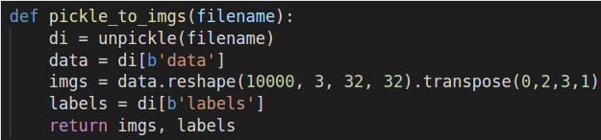
1) Acquiring images
ImageSoup
A simple Python library for quickly scraping images by a certain query
Cifar-10
A classic dataset of 60000 small images.

Slide 6
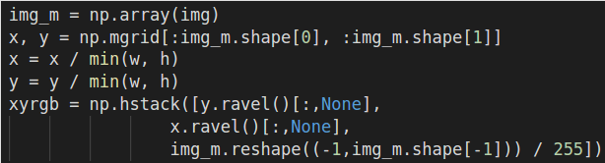
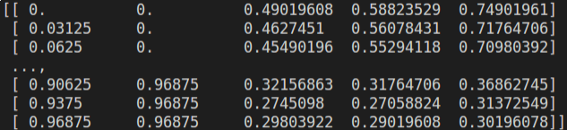
2) Images to XYRGB
Flattened meshgrid
Each 5-D unit has its coordinates normalised by the shortest side
Normalised RGB
We normalise the RGB components to [0, 1].

Slide 7
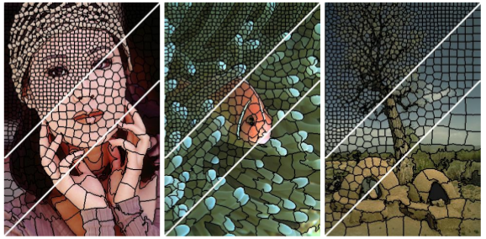
3) Superpixels (SLIC)
Inspiration: SLIC
SLIC superpixels use a combination of physical and chromatic distance in the La*b* space

Slide 8
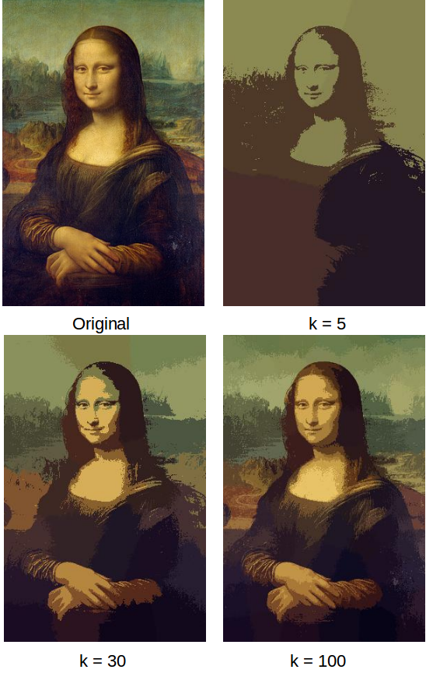
3) Superpixels
XYRGB clustering
The simplest model: X, Y, R, G, B are considered similarly, but the first two are “tweaked”.

Slide 9
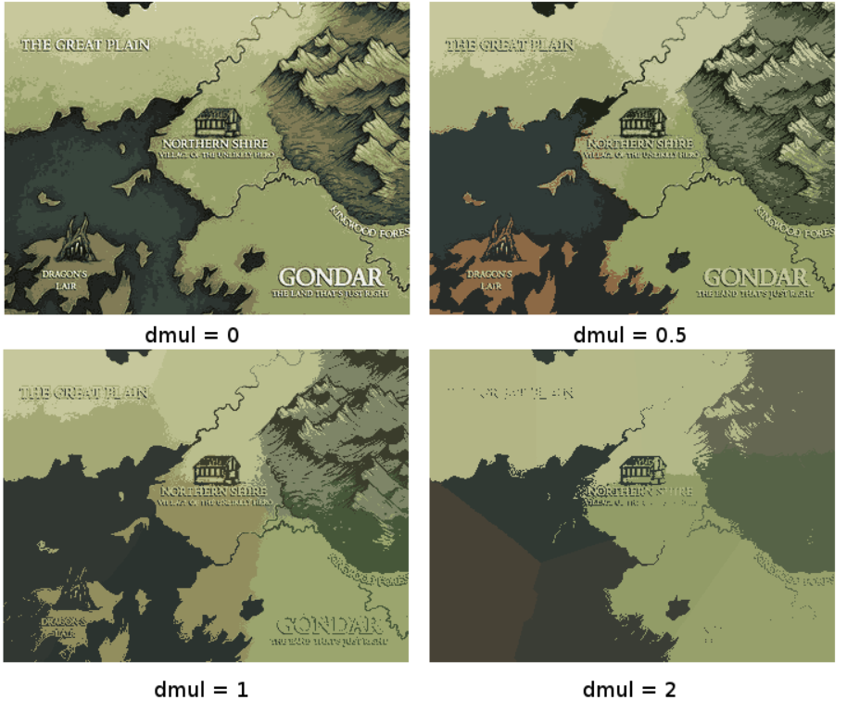
Distance multiplier
X and Y can be multiplied by a custom parameter for various effects
Low dmul
Colour reduction
High dmul
Equivalent to average-pooling

Slide 10
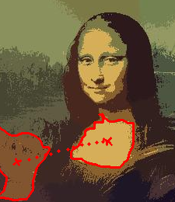
3) Superpixels to input
“Cellbatch” uses the averages of each superpixel
“Relbatch” uses batches of relationships

Slide 11
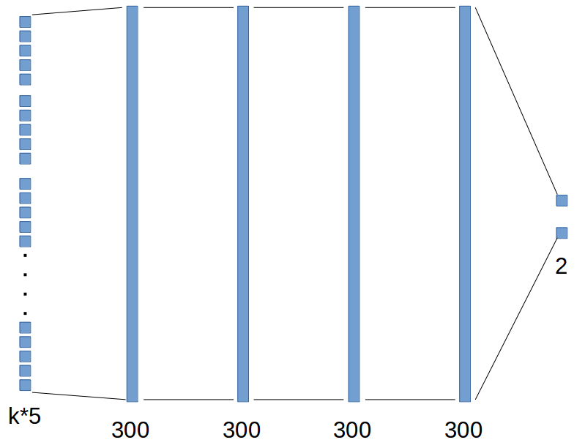
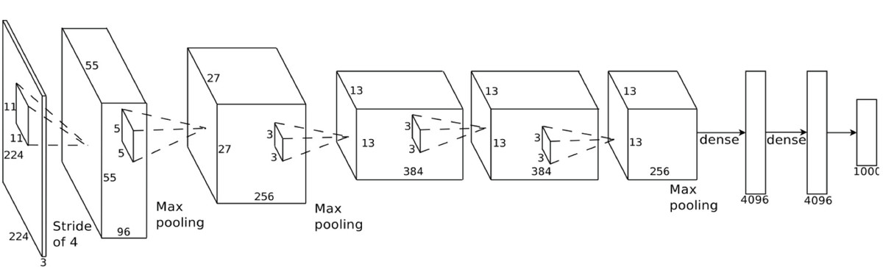
4) The neural network
CNN
Cellbatch

Slide 12
Rules
30 clusters
20 epochs
All images
We track accuracy and time
Benchmark: flat, fully-connected network
Other parameters
Each algorithm has its own parameters, and they have been tweaked to roughly similar degrees of complexity

Slide 13
Accuracy for “CIFAR-2”
Cellbatch: ~85%
Relbatch: ~86%
Flat: ~50%
Data size
Cellbatch has reduced the input data to under a tenth of its original size.
Relbatch has increased it slightly, depending on number of relationships.

Slide 14
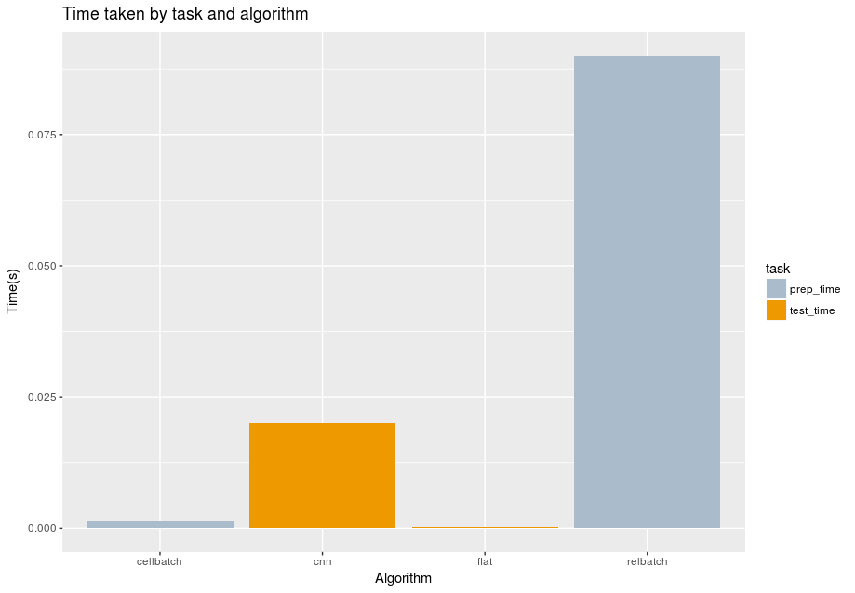
Timing

Slide 15
Further work
Better use of the superpixels’ immediate neighbourhood
Cluster analysis on superpixels
SLIC-like optimisations (limited search space)

Slide 16
Conclusions
Reasonable accuracy with very fast training times
Simple architecture
Flexible input size and type
Substantial data reduction
Effort moved to preprocessing, testing is almost instant: can prepare data regardless of network architecture

Slide 17
Gif, demos (changing dmul)

Slide 18
Questions

